Slide 1
NCI-CBITT
George Zaki and Peng Wang

Slide 2
Task Listed on Day 1
Analyze 2 GPU scaling
Optimize GPU kernels
Analyze overall performance bottleneck

Slide 3
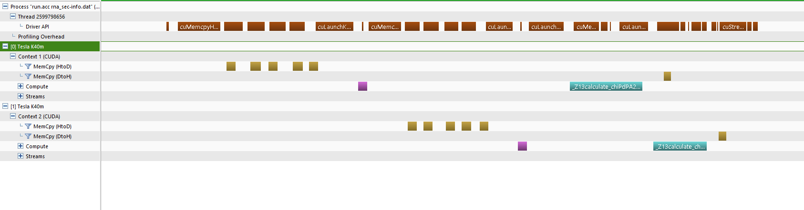
2 GPU Scaling
Figure out reason for poor scaling: kernel too short, dominated by launch overhead

Slide 4
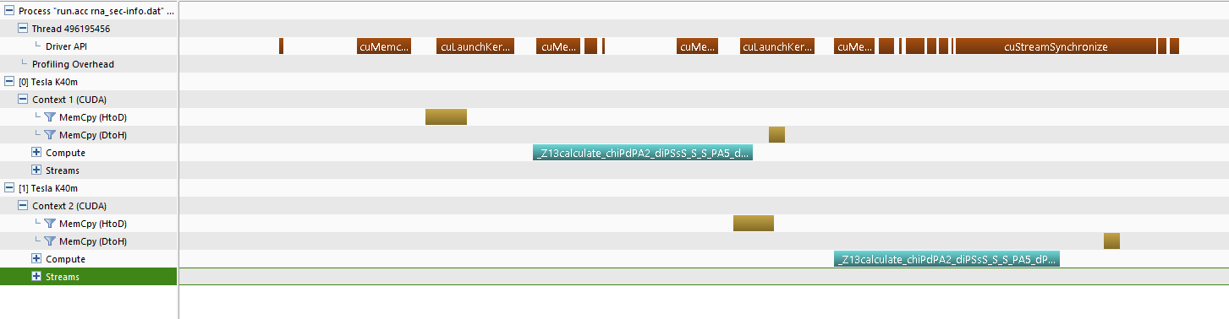
Improve 2 GPU Scaling
Reduce launch overhead
Merge multiple memcpy into one by allocating one array and doing pointer math
Move a small kernel to CPU
Should be better for larger problem

Slide 5
Improve 2 GPU Scaling
1 GPU improves by ~5%; 2 GPU improves by ~10%.

Slide 6
Kernel Optimization
openacc, 42 ms, K40 | K20X (ms)
cuda | 46.5
smem for scat_par_rest | 42.5
smem for atom_type_map | 34
LDG for distances | 39.4
L1 for distances | 34.3
sinf | 27
sqrtf | 25.3
"f" for index formula | 24.7
LDG for distances | 23.4
"ftz,prec-sqrt,prec-div" | 23
Rewrite OpenACC loop in CUDA, got ~2X speedup
Apply “sinf & sqrtf” trick to OpenACC, 42 ms => 34 ms

Slide 7
GPU Part Speedup: 43%
Elapsed time for compute routine
memcpy, kernel, launch overhead, sync, etc

Slide 8
Overall Application Time

Slide 9
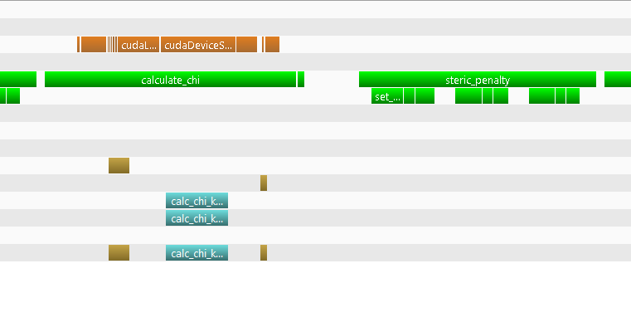
CPU is the bottleneck
GPU
CPU
steric_penalty function the most time consuming CPU function
Port data management to CUDA, so we can use Intel compiler for CPU part
Didn’t help much, even though initially gprof suggested it will
Rewrite the STL-based data structure to use C array, replace STL algorithm by a custom one: ~ 5X

Slide 10
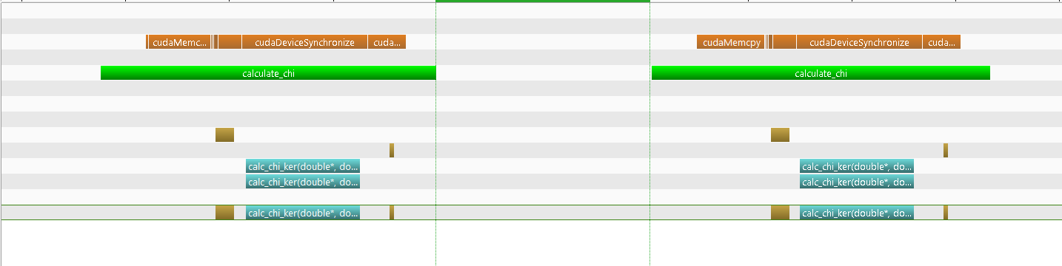
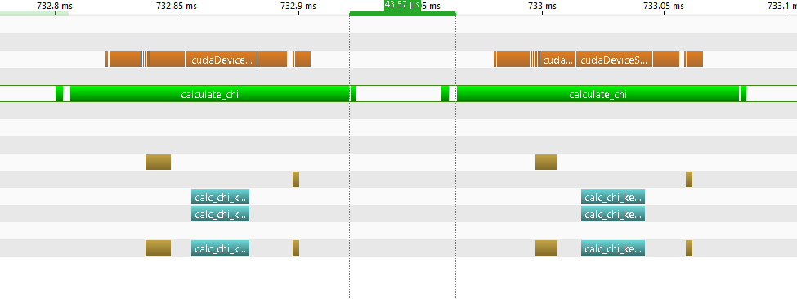
CPU Time: 103 us => 43 us

Slide 11
Overall Application Time
2.1X improvement compared to day 1

Slide 12
Performance Summary

Slide 13
Lesson Learned
gprof gave misleading profiling with intel compiler
or it needs special attention to compiler flags to work properly
We can reduce multi-GPU launch overhead using OpenMP
Porting is easier in OpenACC than CUDA. However:
OpenACC doesn’t always play nice with OpenMP, bug not fixed in 16.4
OpenACC-CUDA interop didn’t work on 2 GPUs
“cache” cannot match explicit shared memory control

Slide 14
Plan
Run bigger problem for multi-GPU scaling
Port the IDL code to GPU

Slide 15
Thanks You!
UDel – We ate a lot!
ORNL – Scrums help!
NVIGIA-PGI – Keep the good tools coming!
Peng Wang – Great team work!

Slide 16
Backup

Slide 17
Pushed math optimization a bit too far
“sinf” & “sqrtf” helped
Add “-use_fast_math”: NaN
sqrt(15625)=125:
w/o use_fast_math: 125
w/ use_fast_math: 124.999992
int(sqrt(15625)):
w/o use_fast_math: 125
w/ use_fast_math: 124

Slide 18
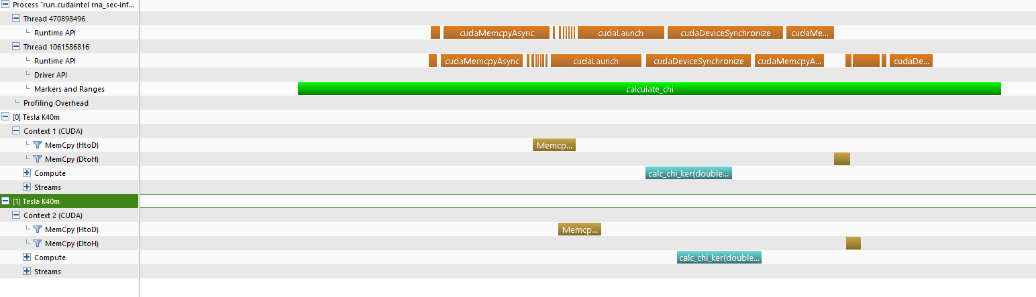
CUDA+OpenMP
Overlapping launch overhead

